Slide 1
Microarchitecture Design & Operation
Suggested Reading: Chapter 4 from Tanenbaum, Structured Computer Organization, 5/6ed, Pearson

Slide 2
The Data path
IJVM

Slide 3
Objectives
At the end of this section, you will be able to
Understand the data path of a hypothetical architecture
Understand data-path timing
Understand how the data path is controlled

Slide 4
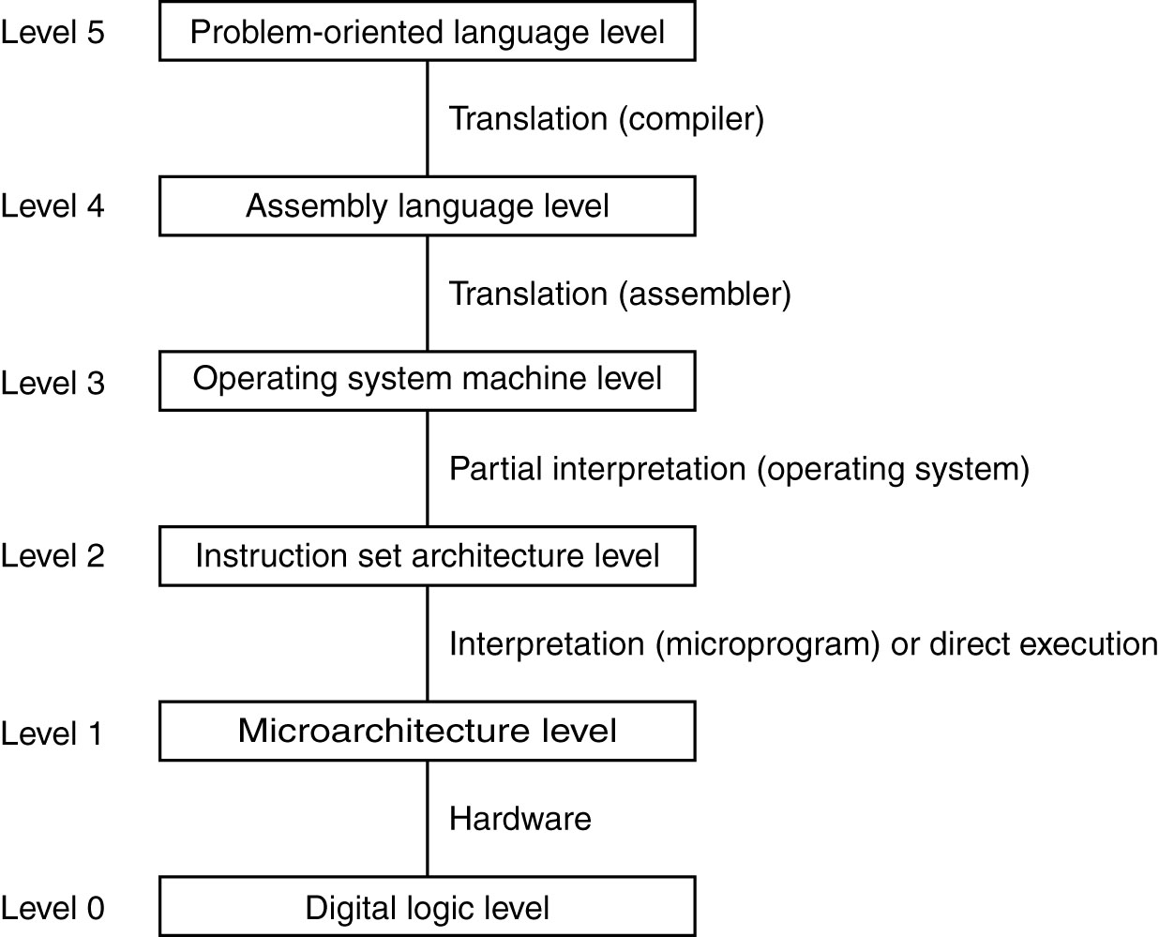
Contemporary Multilevel Machines
A six-level computer.
The support method for each level is indicated below it .

Slide 5
Example: IJVM
Integer JVM
Subset of JVM
Will design hardware to interpret IJVM byte code (Java assembly language)
Microprogram (in ROM)
Fetch-decode-execute IJVM instructions
interpreter

Slide 6
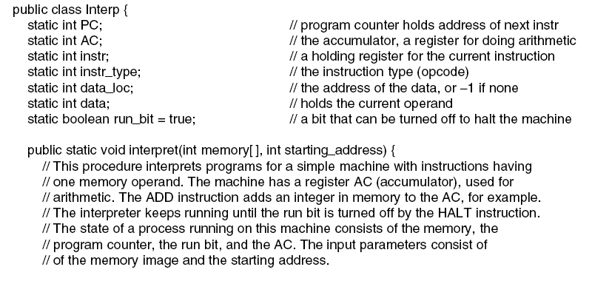
Interpreter (1)
. . .
An interpreter for a simple computer (written in Java).

Slide 7
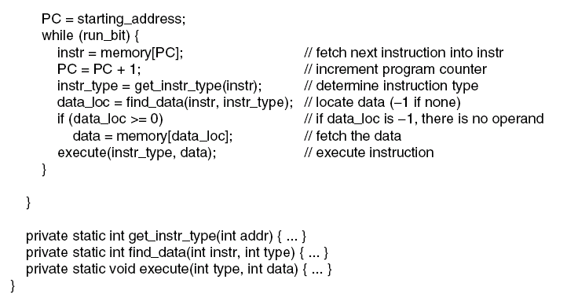
Interpreter (2)
An interpreter for a simple computer (written in Java).

Slide 8
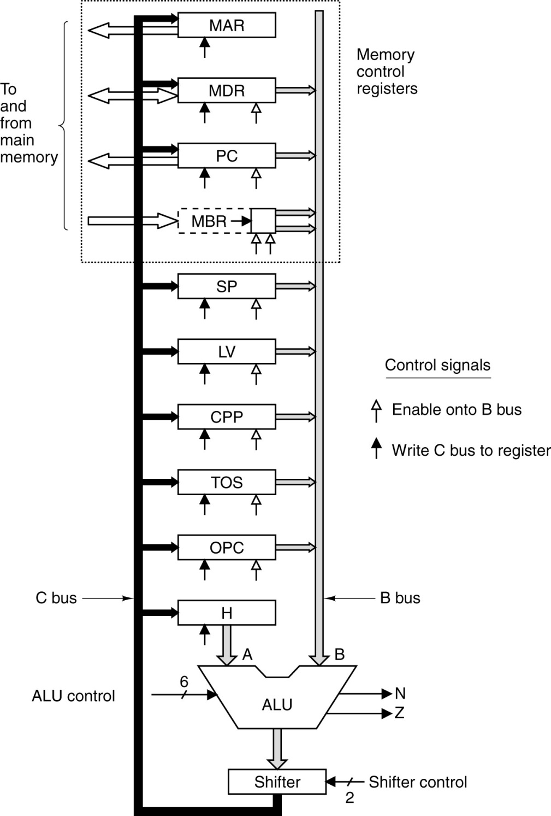
IJVM Data Path
32–bit registers (except MBR: 8-bit register)
Registers accessible only by the microprogram
Correspond to a variable with a similar name in ISA
Registers drive their contents onto the B-Bus to the ALU
ALU output drives the shifter and then the C-Bus
C-Bus can write any register(s)

Slide 9
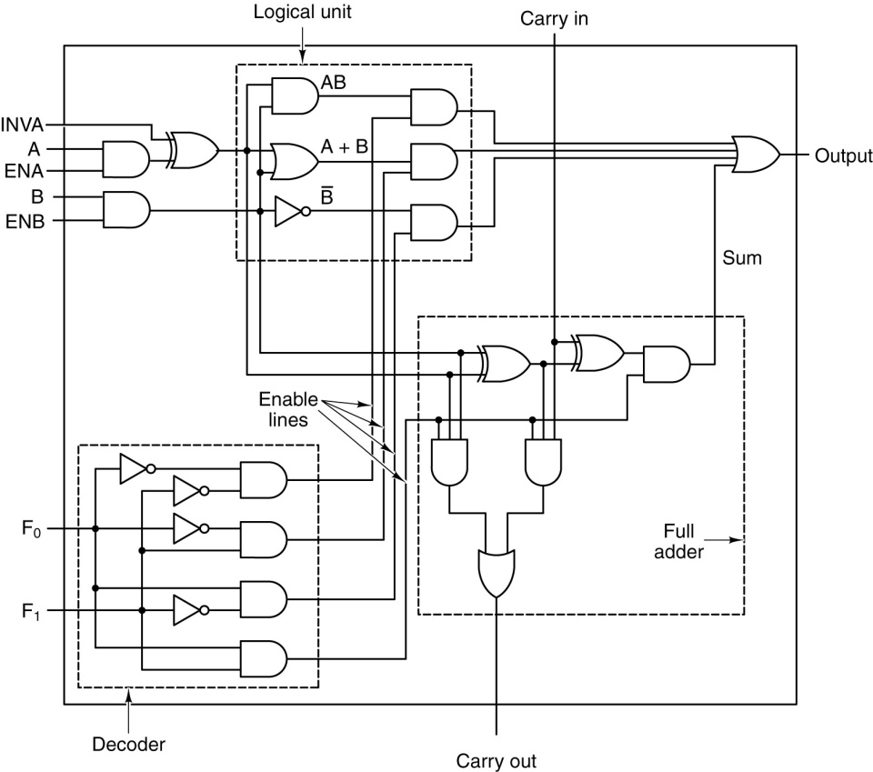
ALU
Except: 32-bit ALU

Slide 10
ALU Controls
6 controls:
F0 & F1 : ALU function
ENA
ENB
INVA
INC : add 1 to the result

Slide 11
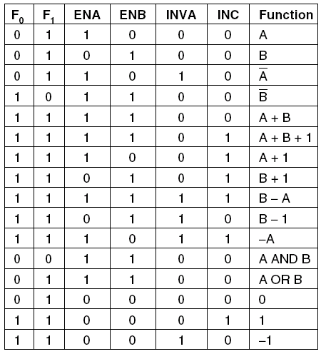
ALU Signal Combinations
Useful combinations of ALU signals and the function performed.

Slide 12
AND Function (00)
Useful combinations of ALU signals and the function performed.

Slide 13
OR Function (01)
Useful combinations of ALU signals and the function performed.

Slide 14
NOT Function (10)
Useful combinations of ALU signals and the function performed.

Slide 15
Adder Function (11)
Useful combinations of ALU signals and the function performed.

Slide 16
ALU Inputs
B can be loaded from ONE of 8 registers, in 9 ways
Loaded from H only:
H can be loaded from any of the registers feeding the B-bus, unchanged through the ALU

Slide 17
Shifter
2 controls:
SLL8 : shift left logical 1 byte, 8 least significant bits are zeroed
SRA1 : shift right arithmetic by 1 bit leaving the most significant bit unchanged

Slide 18
Data Path Timing
It is possible to read and write the same register in one cycle
Example: increment SP
Put SP on B-bus
Pass it through the ALU with no left input and INC asserted
Store it in SP
This is possible due to data path timing

Slide 19
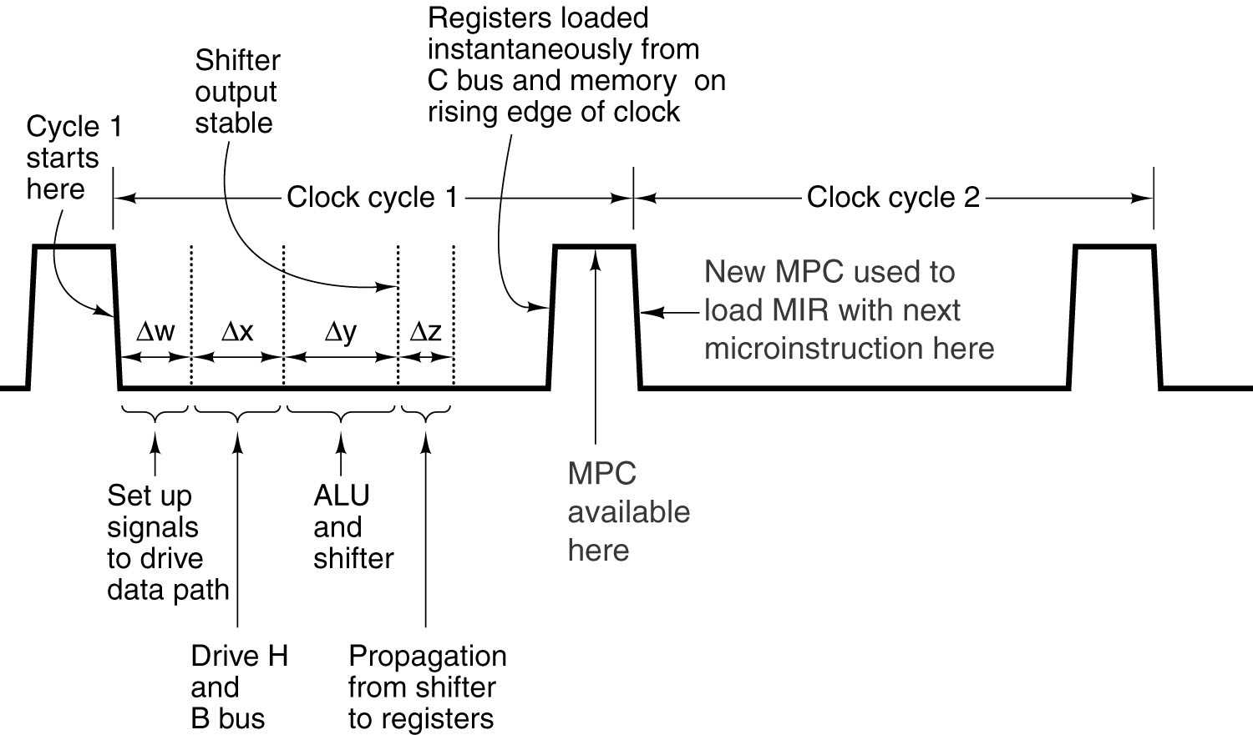
Data Path Timing
ALU/Shifter runs all the time
No clock pulse that triggers it to run
Output is garbage before
Δw + Δx + Δy from the cycle start time
Timing diagram of one data path cycle.

Slide 20
Registers
Memory Address Register
Memory Data Register
Program Counter
Memory Byte Register
Stack Pointer
Local Variables
Constant Pool Pointer
Top Of Stack
Old Program Counter
High order ALU input

Slide 21
Control Signals
Enable Register’s Input from C
Enable Register’s output onto B

Slide 22
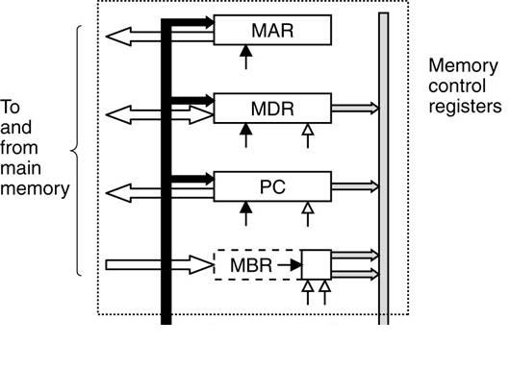
Memory Operation
Communicate with memory via 2 ports
8-bit:byte-addressable controlled by PC
32-bit: word-addressable controlled by MAR and MDR
PC = address of byte which when read goes to MBR
MAR = address of word (32-bits) which when read goes to MDR
MAR = address of word (32-bits) which when written comes from MDR

Slide 23
Memory Operation
MAR contains word addresses
PC contains byte addresses
PC = 2, third byte in memory (byte 2)
Starting a memory read, brings byte 2 to MBR
MAR = 2, third word in memory (bytes 8-11)
Starting a memory read brings 4 bytes to MDR
PC/MBR: read ISA-level instructions (byte code)
MAR/MDR: read ISA-level data

Slide 24
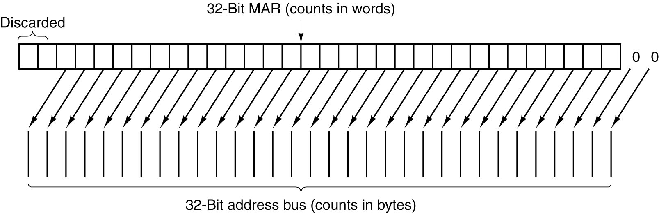
Word Addressing
Actual physical implementation: memory is byte addressable
MAR is wired into address bus as follows:
Two logical left shifts: multiply by 4
When MAR is 1, address 4 is put on the address bus (word 1 starts at byte 4)
High order bits are discarded: only 4-GB memory is allowed

Slide 25
Byte Addressing
MBR can be copied onto bus B in two ways
Unsigned or signed
Unsigned: (0)²⁴MBR is put on B
Useful when assembling 16 bit integer
Signed value [-128, 127]
(MBR[7])²⁴MBR is put on B (Sign extension)

Slide 26
Data Path Cycle
Gating registers out on B
ALU and shifter operation
Driving the output on C
Storing C into one or more registers
In addition:
Memory operations, if any, start at the end of the cycle

Slide 27
Memory Operation Timing
MDR/MBR loaded
here
Memory is working
Data brought
From memory
Available now
Start memory
operation
somewhere here
Input to MDR/MBR
Is ready
MDR/MBR can be
used while
another mem read
is in progress
Registers are loaded at the rising edge of the clock
ASSUMES memory takes one cycle: not true in reality, but simplifies design

Slide 28
Control Signals
Memory Control Signals
Enable Register’s Input from C
Enable Register’s output onto B
Control the ALU and Shifter

Slide 29
Controlling the Data Path
Need 29 signals:
9 to enable register output on B
8 to control ALU and shifter
9 to enable register input from C
2 to indicate memory read/write via MAR/MDR
1 to indicate memory fetch via PC/MBR
24
4

Slide 30
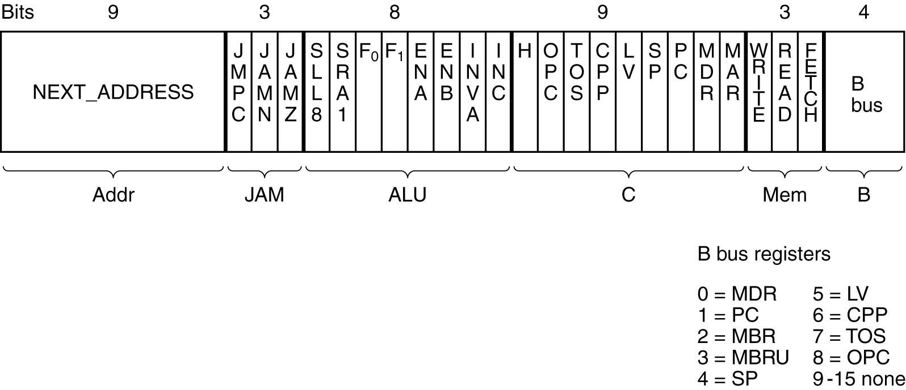
Controlling the Data Path
So, we need 24 bits to control the DP for one cycle (one microinstruction)
Ignore for now
36 bit microinstruction

Slide 31
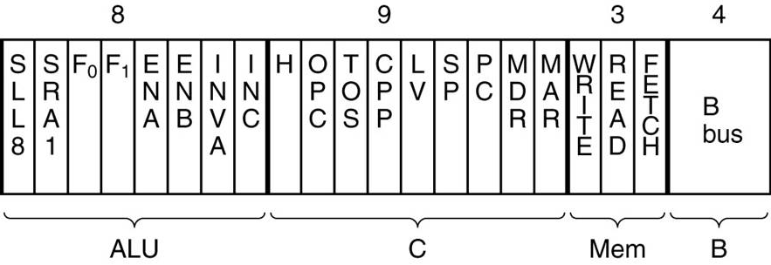
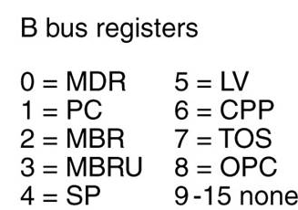
Microinstructions

Slide 32
4-16 Decoder
4-16 decoder

Slide 33
4-16 Decoder
4-16 decoder
0
0
0
0

Slide 34
4-16 Decoder
4-16 decoder
0
0
0
1

Slide 35
4-16 Decoder
4-16 decoder
0
1
0
1

Slide 36
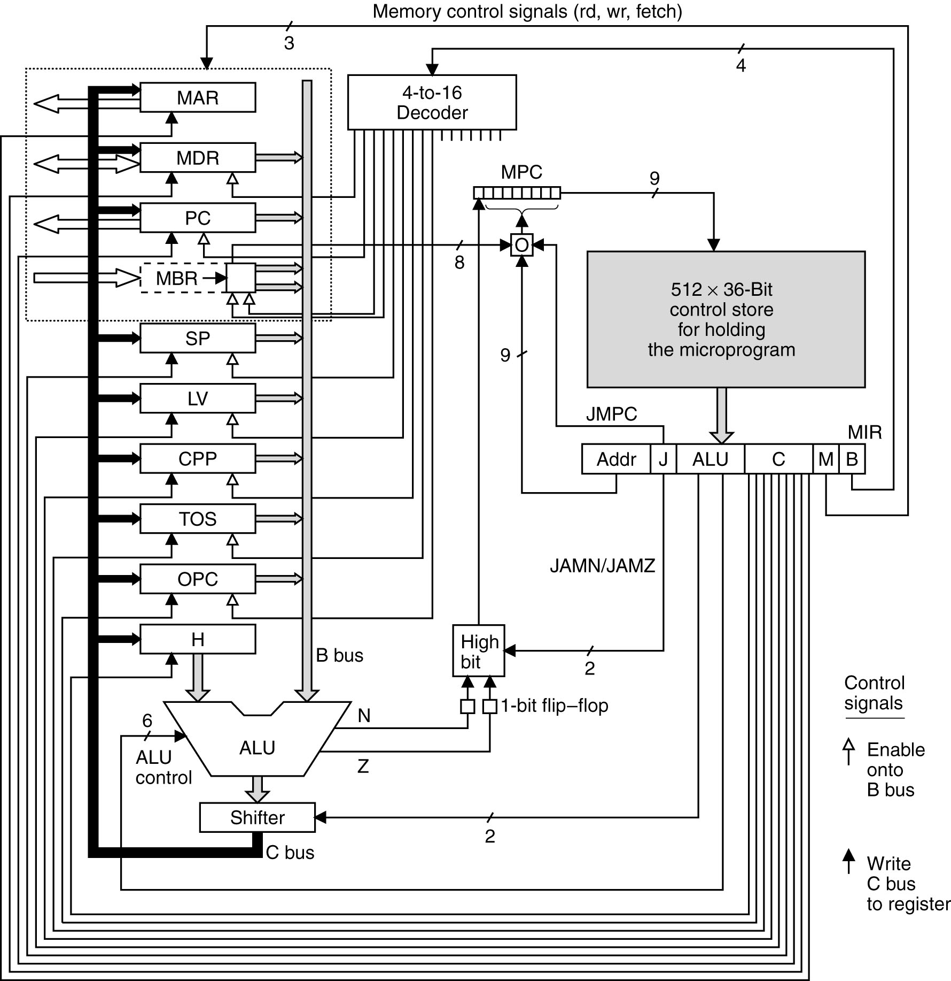
Mic-1

Slide 37
Sequencer
Mic-1 is given an ISA instruction
Sequencer produce
State of every control signal
Next (address) microinstruction to be executed

Slide 38
Mic-1

Slide 39
Mic-1
Think of it as memory holding the microprogram
contains 512 36-bit microinstructions
Unlike main memory, microprogram need not be stored sequentially (very messy)
Instead of incrementing micro program counter, each microinstruction specifies its successor

Slide 40
Next Microinstruction

Slide 41
Mic-1

Slide 42
Mic-1

Slide 43
Mic-1

Slide 44
Notes
MPC = microprogram counter; points to next microinstruction (MI)
The instruction pointed to by MPC is loaded to MIR (MicroInstruction Register)
MIR = ControlStore[MPC]
A single MI sets up the signals for DP and memory
First 4 bytes (B) drive a decoder to select exactly one register to be gated on bus B
Gating more than one register gives an unreliable value and can damage hardware
The memory (M) 3 bits send commands to memory ports: read, write, or fetch
Read=1: MDR = Memory[MAR]
Write=1: Memory[MAR] = MDR
Fetch=1: MBR = Memory[PC]

Slide 45
Notes
The 9 C bits enable as many registers as need to be written at the end of a DP cycle
The 8 ALU bits drive the ALU (6 bits) and the shifter (2 bits)

Slide 46
Mic-1

Slide 47
Data Path Timing
Load
MIR
MIR =
CS[MPC]
N & Z
Timing diagram of one data path cycle.

Slide 48
Mic-1
Δw
Δx
Δy
Δz

Slide 49
Next Microinstruction
JAM: three Jumping bits

Slide 50
Next MI
Either:
NEXT_ADDRESS does not change, or
NEXT_ADDRESS[8] is set to 1
(JAMZ AND Z) OR
(JAMN AND N) OR
NEXT_ADRRESS[8]

Slide 51
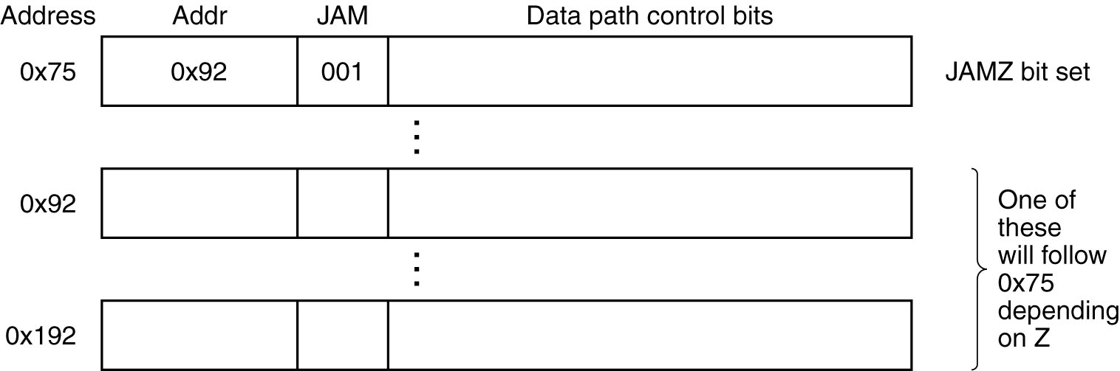
Next Microinstruction
JAMZ
Next if Z flip-flop = 0
Next if Z flip-flop = 1
A microinstruction with JAMZ set to 1 has two potential successors.

Slide 52
Mic-1
If JMPC == 1
MBR OR (bw) NEXT_ADDRESS[0..7]
Else
Pass NEXT_ADDRESS as is from previous MI

Slide 53
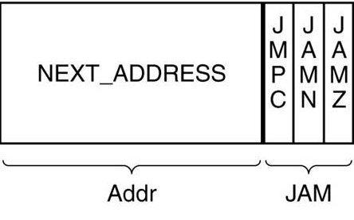
JMPC & MBR
1
Or
0
0
0
0
0
0
0
0
1
When JMPC == 1, NEXT_ADDRESS[0..7] is typically 0’s
NEXT_ADDRESS[8] = 0 or 1
MBR has a fetched opcode from main memory
Oring Next_ADDRESS[0..7] with MBR gives a unique address in the micro store
This address is the first microinstruction where interpretation of the opcode starts

Slide 54
MBR

Slide 55
Data Path Timing
Including MDR and MBR, if at all, from cycle 0
Load
MIR
MIR =
CS[MPC]
Need MBR, N, and Z
N & Z
Timing diagram of one data path cycle.

Slide 56
Mic-1

Slide 57
CPU Clock Speed
The time it takes for DP cycle (microinstruction execution) defines the CPU clock speed
For example, a 3.0 GHz CPU can execute 3 billion microinstructions per second
Or, 3 microinstructions in a nanosecond

